Slide 1
HIBERNATE
CIT 360 GROUP 4 EDGAR ROMERO

Slide 2
CODING TOPIC INTRODUCTION
What is it and Facts
This is an ultra high performance object / relational persistence and query service for Java. It let us develop persistent objects. It is license under the open source GNU Lesser General Public License (LGPL) and is free to download. Hibernate not only takes care of the mapping from Java classes to database tables but also provides data query and retrieval facilities.
True transparent persistence
Query language aligned with SQL
Does not use byte code enhancement
Free/open source
References
Doing more with Java, page 86
Hibernate:
https://www.youtube.com/watch?v=slUn_c_A6LA&feature=youtu.be
https://www.tutorialspoint.com/hibernate/
https://howtodoinjava.com/hibernate-tutorials/

Slide 3
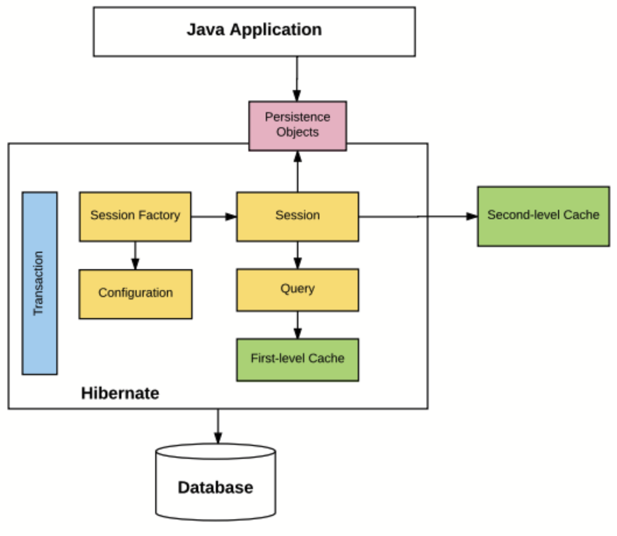
HIBERNATE Architecture

Slide 4
HIBERNATE Architecture EXPLANATION
Let’s understand what each block represents.
Configuration : Generally written in hibernate.properties or hibernate.cfg.xml files. For Java configuration, you may find class annotated with @Configuration. It is used by Session Factory to work with Java Application and the Database. It represents an entire set of mappings of an application Java Types to an SQL database.
Session Factory : Any user application requests Session Factory for a session object. Session Factory uses configuration information from above listed files, to instantiates the session object appropriately.
Session : This represents the interaction between the application and the database at any point of time. This is represented by the org.hibernate.Session class. The instance of a session can be retrieved from the SessionFactory bean.
Query : It allows applications to query the database for one or more stored objects. Hibernate provides different techniques to query database, including NamedQuery and Criteria API.
First-level cache : It represents the default cache used by Hibernate Session object while interacting with the database. It is also called as session cache and caches objects within the current session. All requests from the Session object to the database must pass through the first-level cache or session cache. One must note that the first-level cache is available with the session object until the Session object is live.
Transaction : enables you to achieve data consistency, and rollback incase something goes unexpected.
Persistent objects : These are plain old Java objects (POJOs), which get persisted as one of the rows in the related table in the database by hibernate.They can be configured in configurations files (hibernate.cfg.xml or hibernate.properties) or annotated with @Entity annotation.
Second-level cache : It is used to store objects across sessions. This needs to be explicitly enabled and one would be required to provide the cache provider for a second-level cache. One of the common second-level cache providers is EhCache.
Diagram 1: the application controller pattern as a class diagram

Slide 5
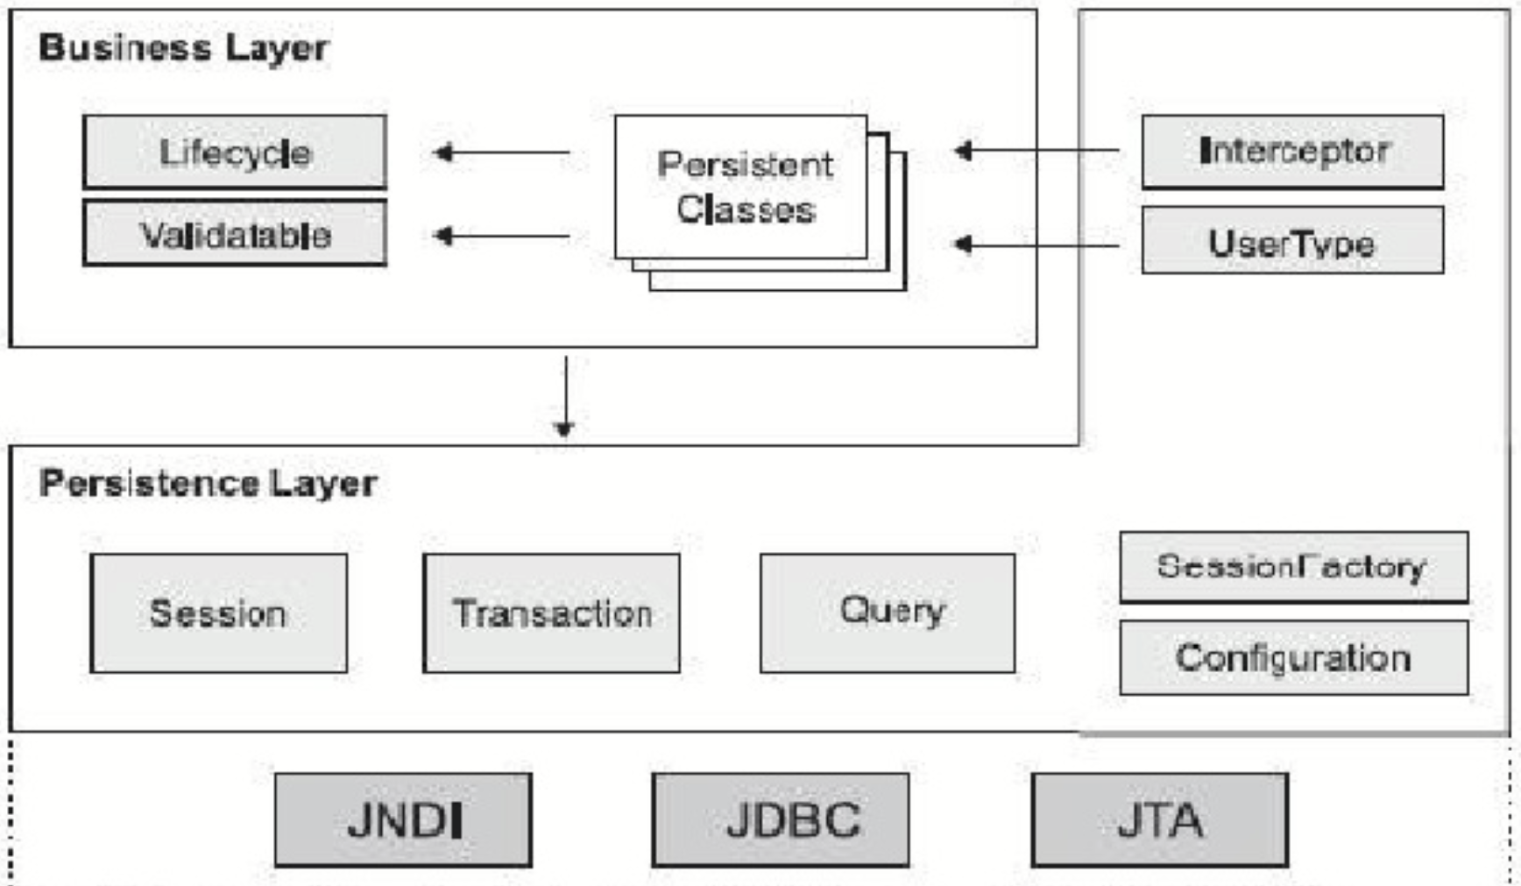
HIBERNATE Architecture EXPLANATION

Slide 6
HIBERNATE Architecture ADVANTAGES
It is simple to start it and run it
It is not intrusive to the build / deploy process
Persistence objects can follow common java idioms: Association, Inheritance, Polymorphism, Composition, Collections
Most of the cases Java objects do not even know they can be persisted.
Developers can focus on object modeling
Query mechanism closely resembles SQL so learning curve is low

Slide 7
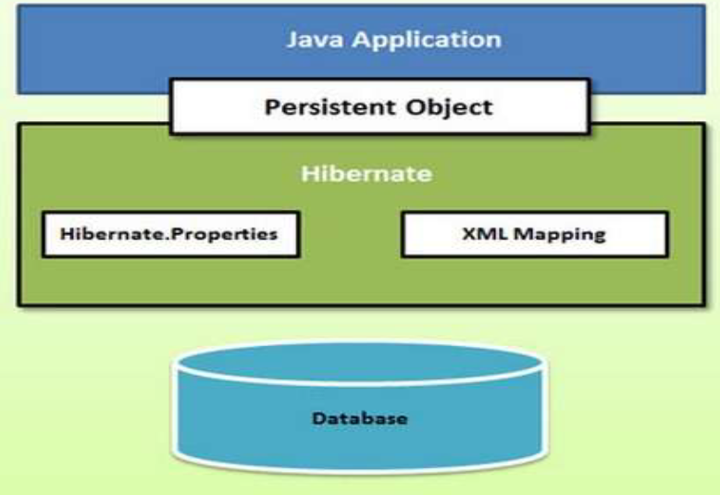
HIBERNATE Architecture
Diagram 1: the application controller pattern as a class diagram

Slide 8
HIBERNATE Architecture ADVANTAGES
 Configuration Object:
The Configuration object is the first Hibernate object you create in any
Hibernate application and usually created only once during application
initialization. It represents a configuration or properties file required by the
Hibernate. The Configuration object provides two keys components:
Database Connection: This is handled through one or more configuration
files supported by Hibernate. These files
are hibernate.properties and hibernate.cfg.xml.
Class Mapping Setup
This component creates the connection between the Java classes and database
tables.
Hibernate uses various existing Java APIs, like JDBC, Java Transaction API(JTA),
and Java Naming and Directory Interface (JNDI). JDBC provides a rudimentary
level of abstraction of functionality common to relational databases, allowing
almost any database with a JDBC driver to be supported by Hibernate. JNDI
and JTA allow Hibernate to be integrated with J2EE application servers.
Following section gives brief description of each of the class objects involved in
Hibernate Application Architecture.

Slide 9
Hibernate Environment setup
Downloading Hibernate:
Download the latest version of Hibernate http://www.hibernate.org/downloads
Hibernate Prerequisites
S.N. | Packages/Libraries
1 | dom4j - XML parsing www.dom4j.org/
2 | Xalan - XSLT Processor http://xml.apache.org/xalan-j/
3 | Xerces - The Xerces Java Parser http://xml.apache.org/xerces-j/
4 | cglib - Appropriate changes to Java classes at runtime http://cglib.sourceforge.net/
5 | log4j - Logging Framework http://logging.apache.org/log4j
6 | Commons - Logging, Email etc. http://jakarta.apache.org/commons
7 | SLF4J - Logging Facade for Java http://www.slf4j.org

Slide 10
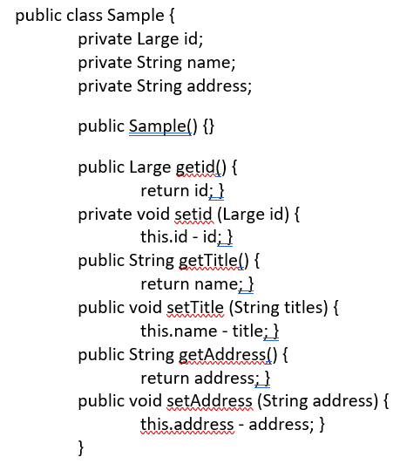
Hibernate configuration file

Slide 11
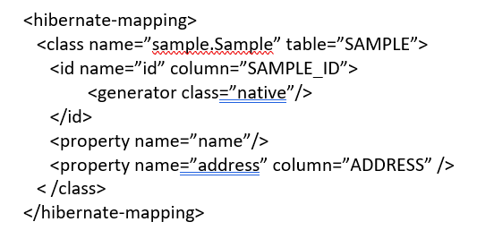
Hibernate Sample file

